Slide 1
AERO-LITE
Turning dirty cabin air into clean CO₂ for chemistry that makes oxygen
Tilak Patel
8th Grade
Thompson Middle School

Slide 2
TWO BROKEN PATHS
CDRA
LiOH Canisters
▸
300 kg — massive system weight
▸
Single-use — consumable, not regenerative
▸
600W — power hungry operation
▸
Resupply mass penalty — hundreds needed for long missions
▸
Complex maintenance, vents CO₂ overboard (impossible on Moon)
Why not LiOH? LiOH canisters are single-use and increase resupply mass. AERO-LITE uses regenerative adsorption to reduce consumables and enable longer-duration missions.
THE GAP
NASA needs a regenerative, lightweight front-end that conditions CO₂ for the Sabatier loop.

Slide 3
DON'T JUST FILTER. PRE-PROCESS.
Current ISS Path
AERO-LITE Path
CDRA
Dry
Concentrated
Pressurized
Carbon Dioxide Removal
Dry → Concentrated → Pressurized
Wet, low-pressure CO₂
Reactor-ready CO₂ feed
Mixed with cabin air, humid
Sabatier Optimized
Choked Feed
Efficient chemistry, closed loop
Sabatier struggles with impure input
Upstream conditioning makes downstream chemistry efficient.

Slide 4
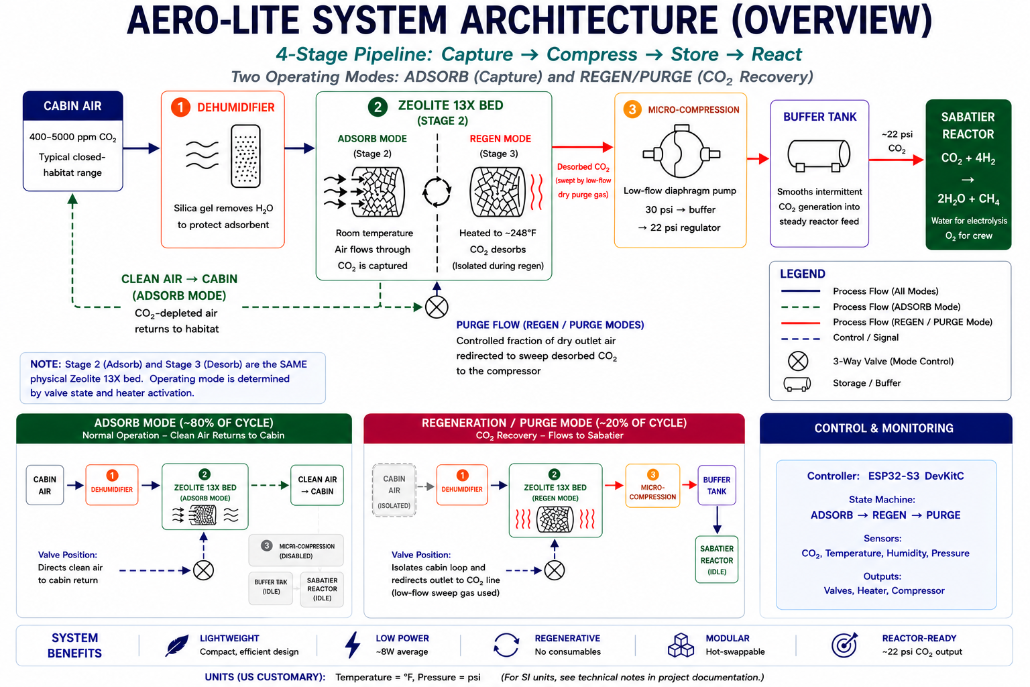

Slide 5
INTELLIGENT BY DESIGN. SAFE BY DEFAULT.
AERO-LITE isn't just a filter. It's a smart system. The Arduino watches six sensors and runs everything automatically..
Sensor Array
6 sensors
Safety Layers
1
Pressure Relief Valve
SCD41
SHT30
Inlet CO₂
Humidity
2
Thermal Cutoff 130°C
DS18B20
BMP280
3
CO₂ Leak Sensor (MQ-135)
Bed Temp
Chamber Pressure
4
Check Valve / Backflow Block
BMP280
OLED
Buffer Pressure
Local Display
5
Backup Cartridge Bypass
Autonomous closed-loop control
Engineering Limitation
Performance depends on thermal regeneration efficiency and may degrade over time due to sorbent aging and dust contamination. We engineered for it, not around it.

Slide 6
RESILIENCE ENGINEERING FOR ARTEMIS
10-unit modular rack with hot-swappable units for continuous operation
AERO-LITE turns CO₂ from a waste problem into a controlled resource for sustaining human life beyond Earth.
If one breaks, you swap it in 30 seconds. The other nine keep running.

Slide 7
THANK YOU
I welcome your questions.
Tilak Patel
Thompson Middle School

